Slide 1
Neural Network Components and Architecture
Visual Presentation on Neural Networks
lijing cui
may 23 2026

Slide 2
Introduction to Neural Networks
Neural networks are machine learning systems inspired by the human brain. They process information using layers of connected neurons to identify patterns, make predictions, and solve complex problems.

Slide 3
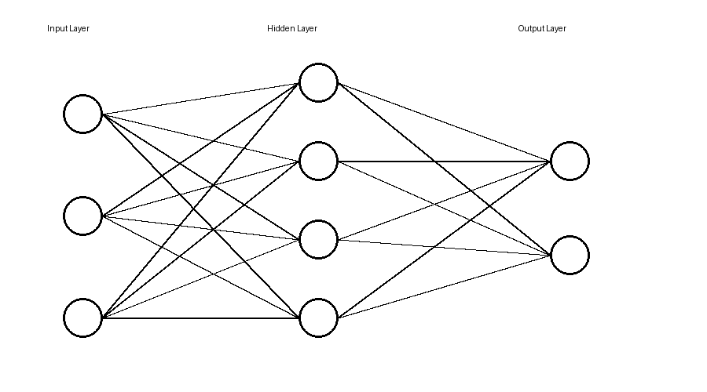
Neural Network Architecture
This diagram shows how information flows through a neural network. The input layer receives data, hidden layers process information, and the output layer produces predictions.

Slide 4
Layers
Layers organize the structure of a neural network. The input layer receives information, hidden layers analyze patterns, and the output layer provides final results.

Slide 5
Neurons
Neurons are small processing units that receive inputs, perform calculations, apply activation functions, and send outputs to other neurons.

Slide 6
Weights
Weights determine the importance of connections between neurons. During training, the network adjusts weights to improve prediction accuracy.

Slide 7
Activation Functions
Activation functions help determine whether a neuron should pass information forward. Examples include ReLU, Sigmoid, and Tanh functions.

Slide 8
Loss Functions
Loss functions measure the difference between predicted and actual values. The objective of training is to minimize the loss.

Slide 9
Optimization Algorithms
Optimization algorithms improve neural network performance by adjusting weights to reduce errors. Common algorithms include Gradient Descent and Adam.

Slide 10
Summary
Visualizing neural networks improves understanding of how AI systems process information. Learning about layers, neurons, weights, activation functions, loss functions, and optimization algorithms provides insight into modern machine learning.

